Slide 1
Online Shoppers Intention Data
Sharanya Bhattacharyya

Slide 2
Content
Problem statement- Why is it useful to answer the question?
Clients and intended audience
Dataset used for investigation
Data cleaning and wrangling
Data visualization
Exploratory Data Analysis(EDA)
Machine Learning Algorithms
Conclusion

Slide 3
Motivation for the Study
Online shoppers intention dataset is rich with consumer information and shopping information.
Contains many important features about customer details, shopping details and timing details of shopping.
The data is used to predict the category of the visitor based on bounce rate, Product related duration, Traffic type, region etc.

Slide 4
Clients / Intended audience
The model can be used by clients to predict the category of the customer type based on their details.
The clientele could be online shopping companies to generate different kind of offers based on their categories and many other things.

Slide 5
Dataset- online shoppers data
The dataset used for this analysis is taken from Uci machine learning repository website and the link of the dataset is given below
https://archive.ics.uci.edu/ml/machine-learning-databases/00468/online_shoppers_intention.csv
The dataset contains many features such as Bounce Rate, Product Related Duration, Region, Special Day etc.

Slide 6
Data cleaning and wrangling
Duplicates are removed from the data set.
df.drop_duplicates(keep=False, inplace=True)
Highly correlated independent variables are removed reduced.
Used correlation matrix to reduce the variables.

Slide 7
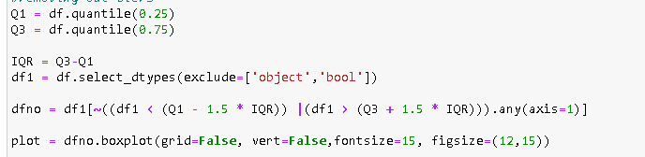
Data cleaning and wrangling
Outliers and missing values are detected with the following snippet.
We can observe of we remove the outliers valuable information is getting removed from the product related duration column so we don’t need to remove the outliers.

Slide 8
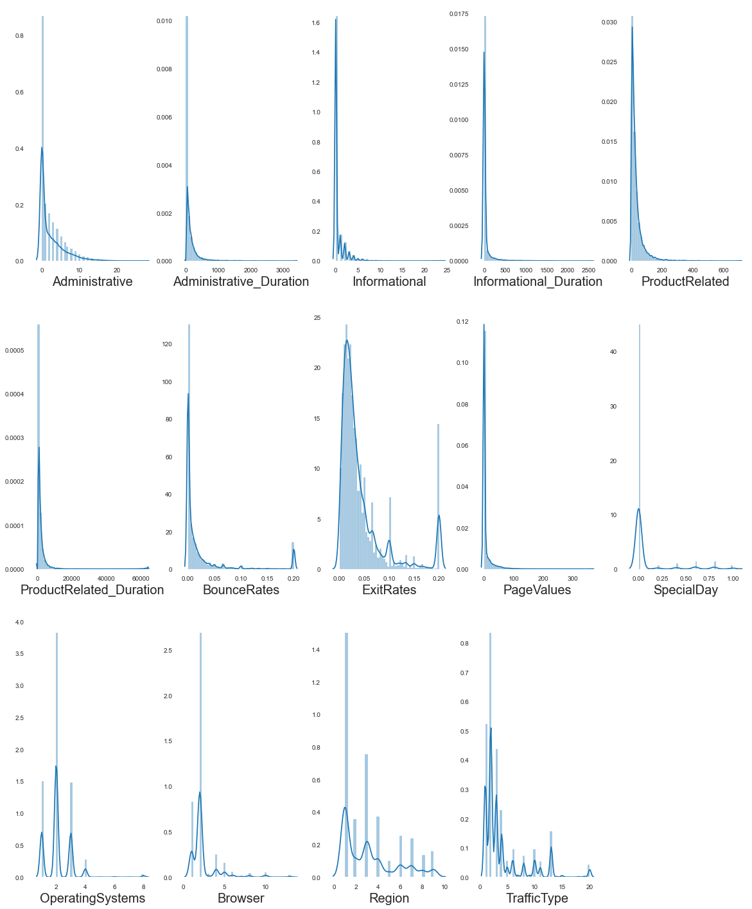
Data Visualization- Independent Variable

Slide 9
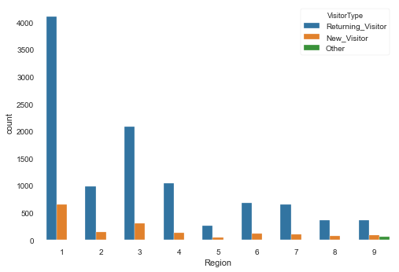
EDA – Region based on Visitor type

Slide 10
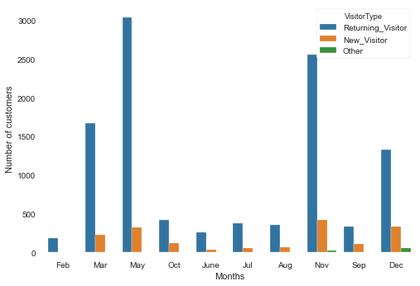
EDA – Month based on Visitor type

Slide 11
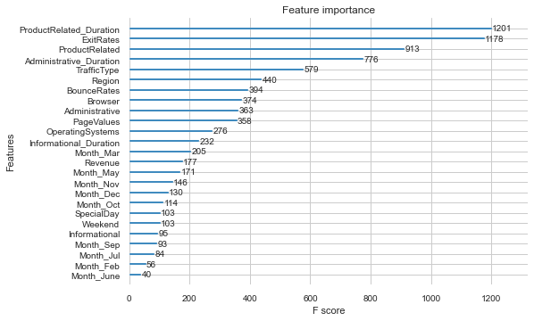
Feature significance of the Model

Slide 12
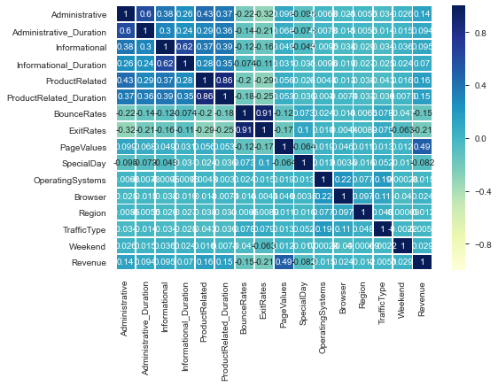
Correlation matrix of features

Slide 13
Machine learning Model comparison
Model | Training accuracy | Testing Accuracy
Random Forest Classifier(imbalanced dataset) | 99.8 % | 87.4
Random Forest Classifier(balanced dataset) hyper tuned with Randomized search CV | 97.7% | 86.4
XGB classifier tuned with Randomized search CV | 99.8% | 86.7%

Slide 14
Machine learning Model comparison
XGBoost model is giving us a slightly better accuracy and because it’s a boosting algorithm is prevents data to be over fitted like decision tree.
We used randomized Search CV because it is faster than GridSearchCv. The hyper Parameter in the model used are,
subsample: 0.8,
silent: False,
reg_lambda: 1.0,
n_estimators: 100,
min_child_weight: 1.0,
max_depth: 20,
learning_rate: 0.2,
gamma: 1.0,
colsample_bytree: 0.7,
colsample_bylevel: 0.5

Slide 15
Conclusion
The number of features in the dataset was only 18 so dimensionality reduction was not needed.
ML algorithm used: Random Forest, XGBoost
Based on accuracy score obtained XGBoost model is giving us slightly better accuracy.
Hyper parameter tuning is done to minimized over fitting using Randomized Search CV.

